Slide 1


APPLICATION-CENTRIC FULL-STACK OBSERVABILITY
Observe Smarter.
Perform Better.
APAC AUTHORISED PARTNER
uObserve™ resolves complex IT disruptions for enterprise organisations by correlating application and infrastructure performance — and it does it without agents.
www.securecentral.com.au
Agentless
Minutes
One console
deployment
to first insight
app · network · compute · storage · VDI · security
Enterprise Briefing • www.uila.com

Slide 2

CONTENTS
What we will cover
A 20-minute walk-through for IT leadership, operations and security teams
01
The enterprise problem
02
uObserve™ at a glance
Why disruptions still take hours to resolve
Three capability pillars in one platform
03
How the tool actually works
04
Live product screens
Observe → correlate → analyse → act
Dependency maps, root cause, VDI, security
05
Architecture & deployment
06
Command-centre operations
Components, models and sizing
Video wall and shift workflow
07
Features, benefits & ROI
08
Customers & next steps
What the organisation gets
Proof and how to start
Uila uObserve™ | Application-Centric Full-Stack Observability
APAC Authorised Partner · securecentral.com.au
02

Slide 3
THE PROBLEM
Enterprise IT is blind between the layers
Modern stacks are virtualised, hybrid and east-west heavy — but the tooling is still siloed
The war room
East-west darkness
Agent fatigue
Unknown dependencies
App, server, network, storage, desktop and security teams each bring a different tool and a different number. Hours are lost proving innocence instead of fixing the fault.
Most traffic never crosses a physical tap. VM-to-VM and container-to-container conversations are invisible to perimeter tooling.
Classic APM needs code instrumentation and agents on every workload — change boards, licences and risk on production systems.
Nobody has an accurate, current map of which service talks to what. Migrations, DR tests and change windows become guesswork.
The business cost
Every minute of degradation is revenue, reputation and regulator risk. Uila publishes an Incident Savings Calculator precisely because most organisations have never quantified what their unplanned downtime and troubleshooting hours actually cost — and what a correlated, agentless view saves.
Uila uObserve™ | Application-Centric Full-Stack Observability
APAC Authorised Partner · securecentral.com.au
03

Slide 4
THE PLATFORM
Three pillars, one agentless platform
Everything below is delivered from the same metadata collection and the same console
Performance Observability
Application Dependency Mapping
App-Centric Cyber Threat Protection
360° view of application, infrastructure,
network and VDI user experience
Automated, dynamic topology tracing
of every tier and external service
East-west traffic inspection for lateral
movement and stealth attacks
Root-cause isolation across compute,
memory, storage and network
Accurate, always-current inventory of
assets and their dependencies
Application behaviour anomaly detection
AIOps-driven remediation actions
Change tracking and policy-violation
detection on the live map
Data-exfiltration and outbound
country/destination insight
Capacity planning & rightsizing
Cloud migration & DR wave planning
Micro-segmentation planning & validation
Delivered as self-hosted software or as a managed SaaS service — the same capability either way.
Uila uObserve™ | Application-Centric Full-Stack Observability
APAC Authorised Partner · securecentral.com.au
04

Slide 5
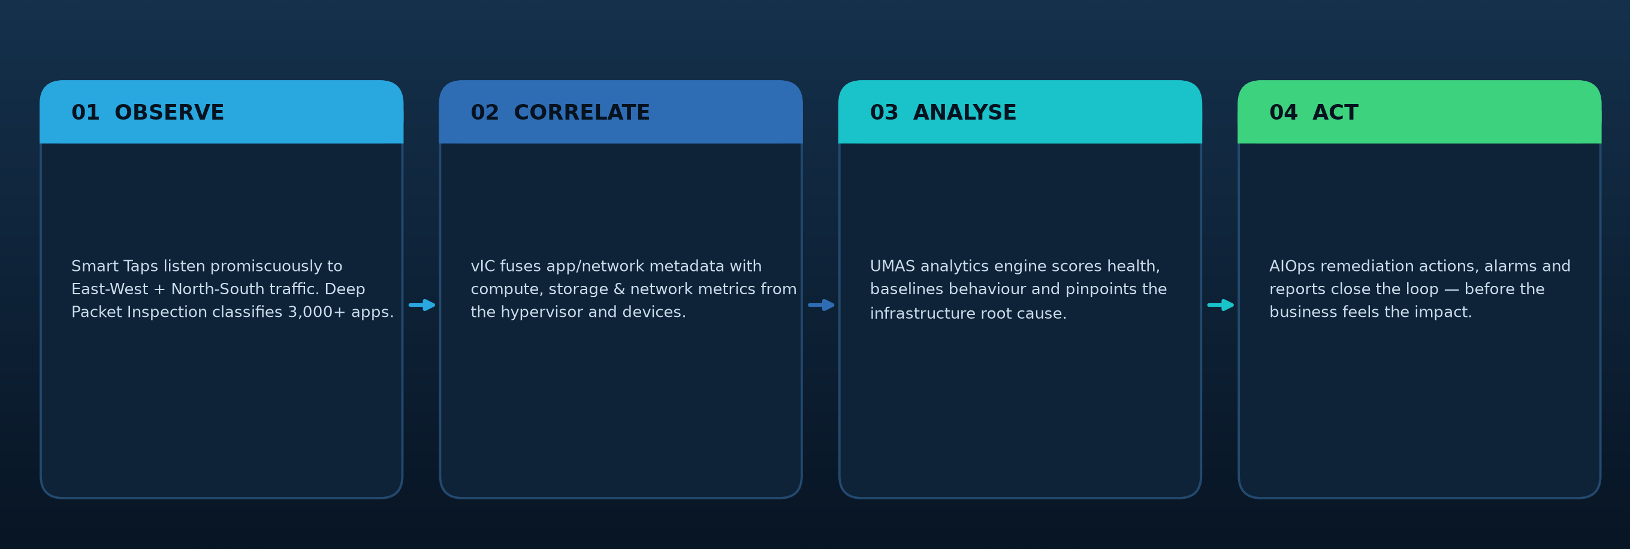
HOW IT WORKS
From metadata to answer in four moves
No code instrumentation, no agents on your production workloads
Deep Packet Inspection reads only the metadata — application identity, response time, network latency, retransmissions, transactions. No packet payload is ever stored, which removes the privacy and legal exposure that comes with full packet capture while still giving you packet-grade evidence.
Uila uObserve™ | Application-Centric Full-Stack Observability
APAC Authorised Partner · securecentral.com.au
05

Slide 6
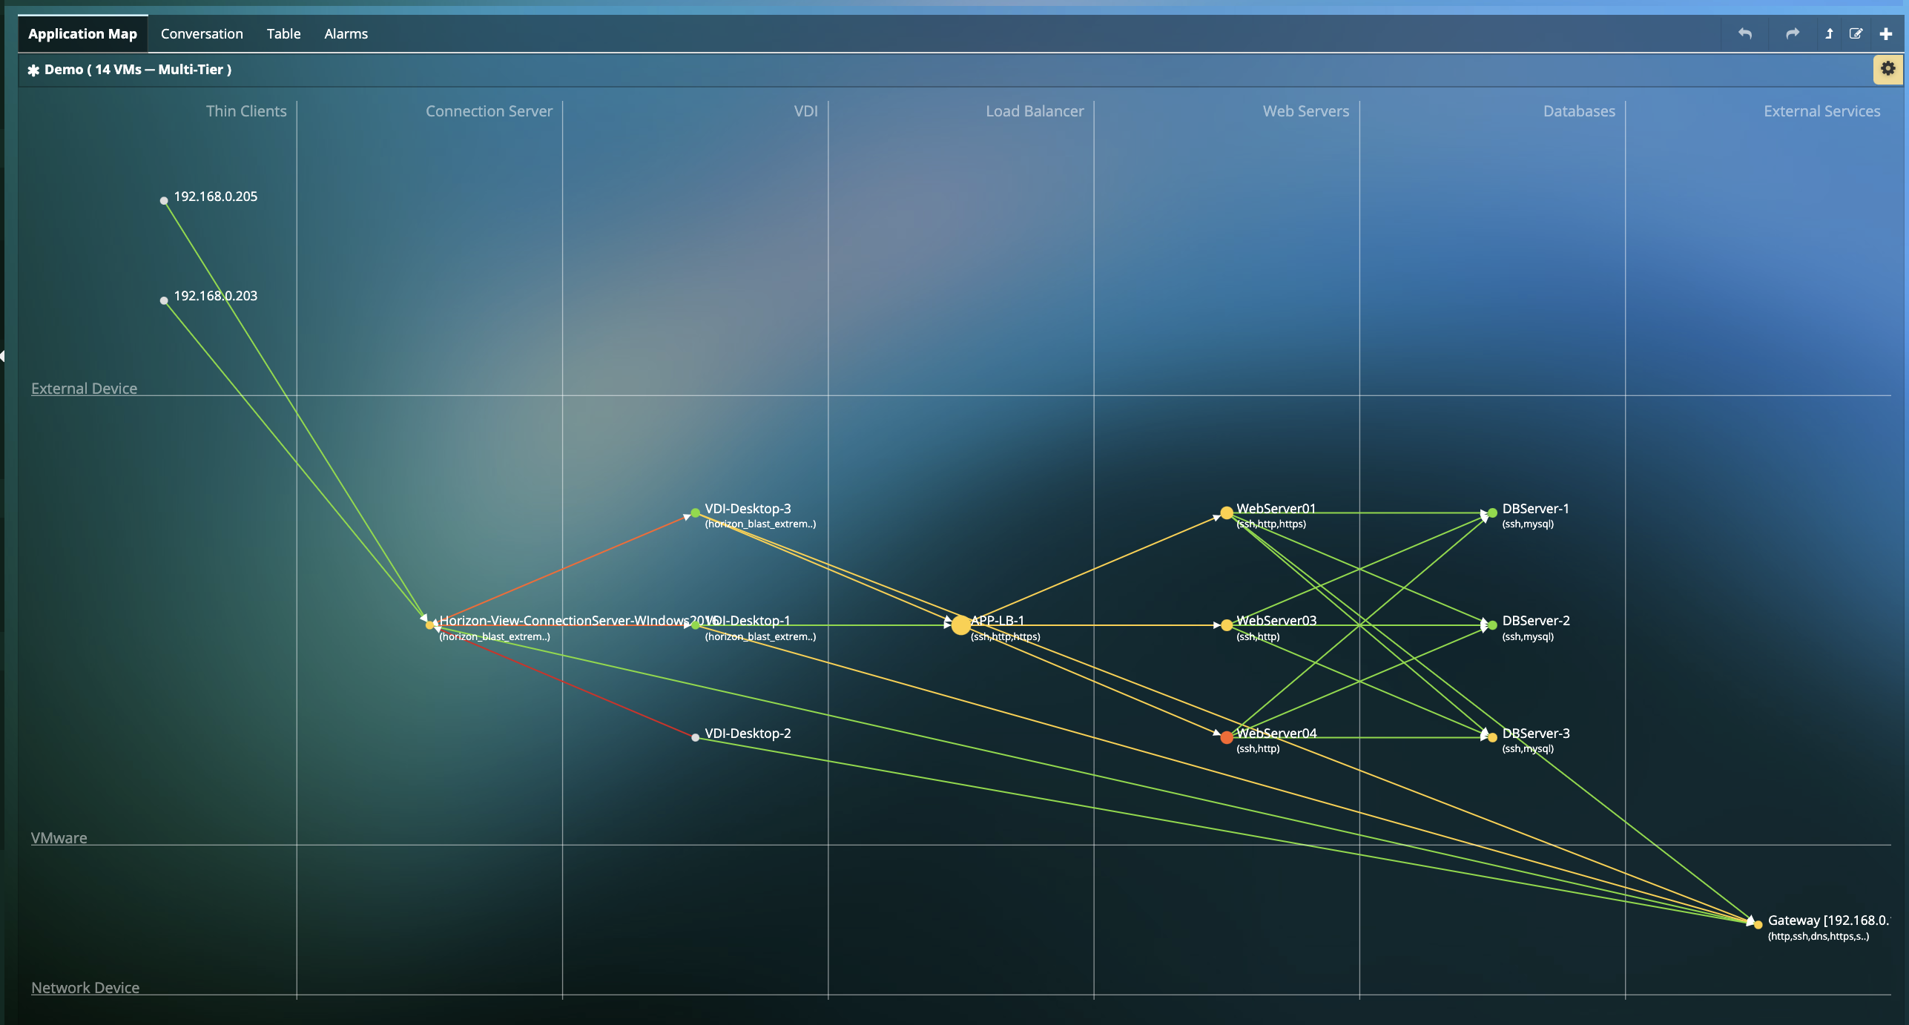
PRODUCT SCREEN 1 OF 5
Application Dependency Mapping
Auto-discovered, multi-tier topology with live health on every node and link
Tiers discovered automatically
Thin clients → connection server → VDI → load balancer → web → database → external services, grouped without any manual configuration.
Colour = health, not guesswork
Green / amber / red is driven by measured application and network response time, so the bottleneck tier is obvious at a glance.
Click straight to root cause
Single-click drill-down from any node into the CPU, memory, storage or network evidence behind the issue.
Use it for: migration wave planning, DR runbooks, change impact analysis and accurate CMDB-grade inventory.
Uila uObserve™ | Application-Centric Full-Stack Observability
APAC Authorised Partner · securecentral.com.au
06

Slide 7
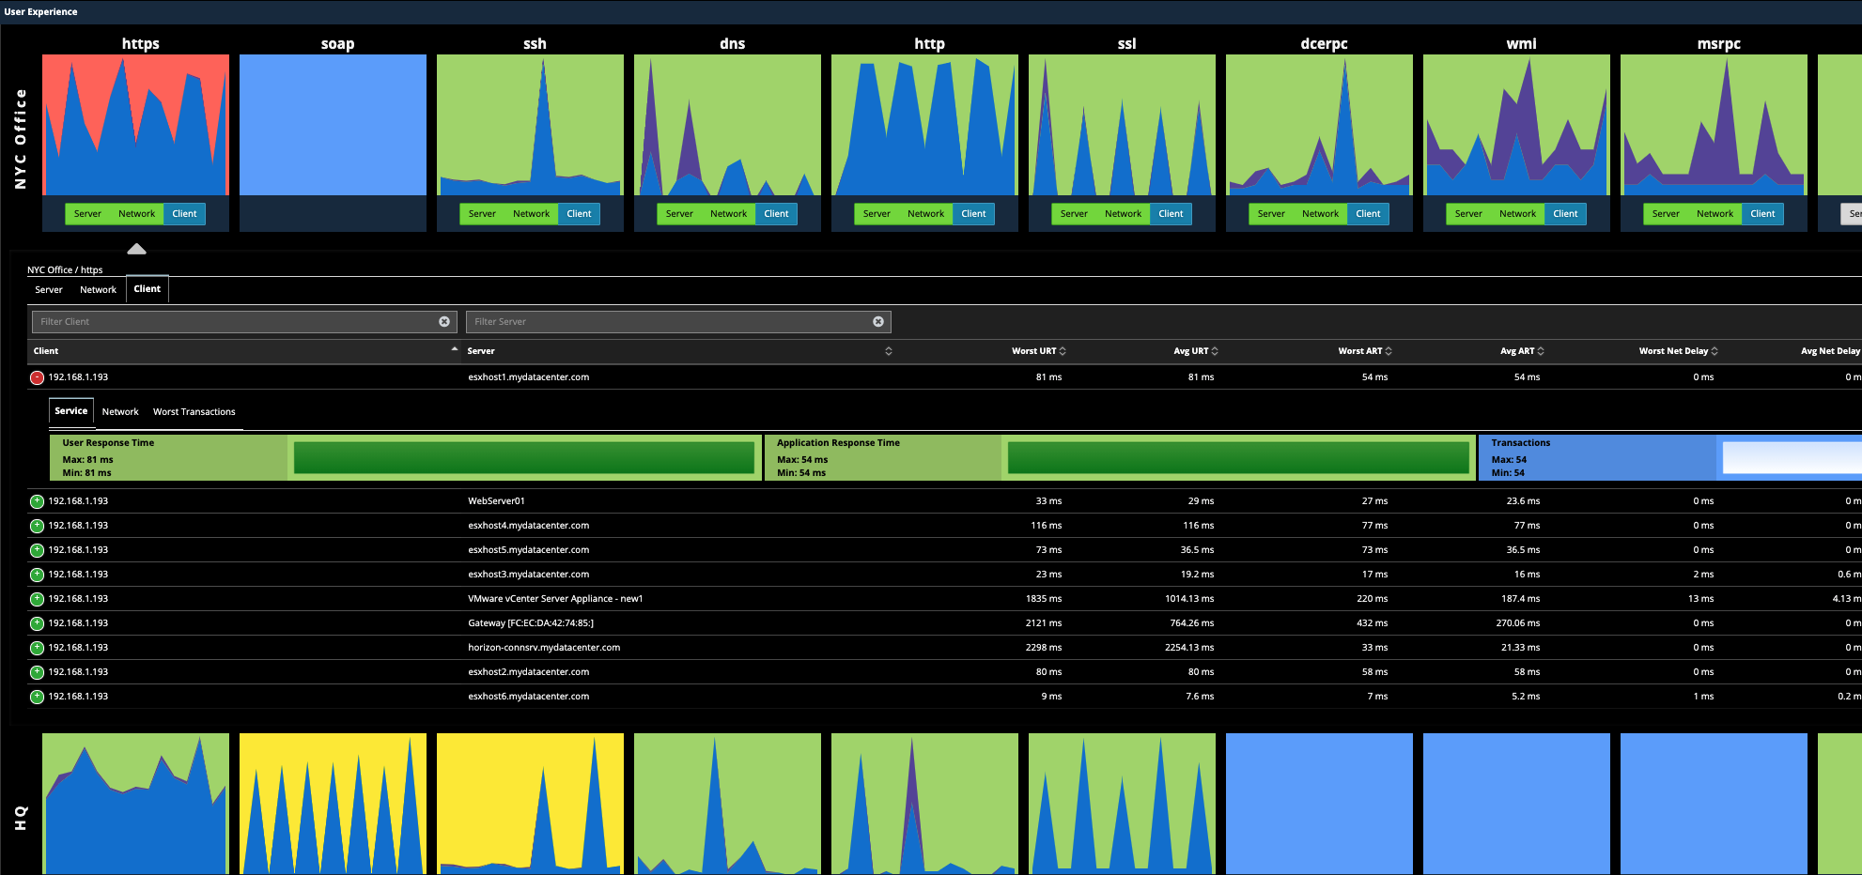
PRODUCT SCREEN 2 OF 5
End-user experience & transaction analysis
Per-site, per-application response time broken into server, network and client contribution
Server vs network vs client
Each application tile splits the delay three ways. The argument about 'is it the network?' is settled before the bridge call starts.
Worst URT / ART, per site
User Response Time and Application Response Time ranked by client, server and site (HQ, branch, remote) with worst transactions listed.
4,200+ apps classified
Uila's DPI engine identifies HTTPS, SQL, DNS, SOAP, DCERPC, WMI, MSRPC and thousands more by behaviour.
Uila uObserve™ | Application-Centric Full-Stack Observability
APAC Authorised Partner · securecentral.com.au
07

Slide 8
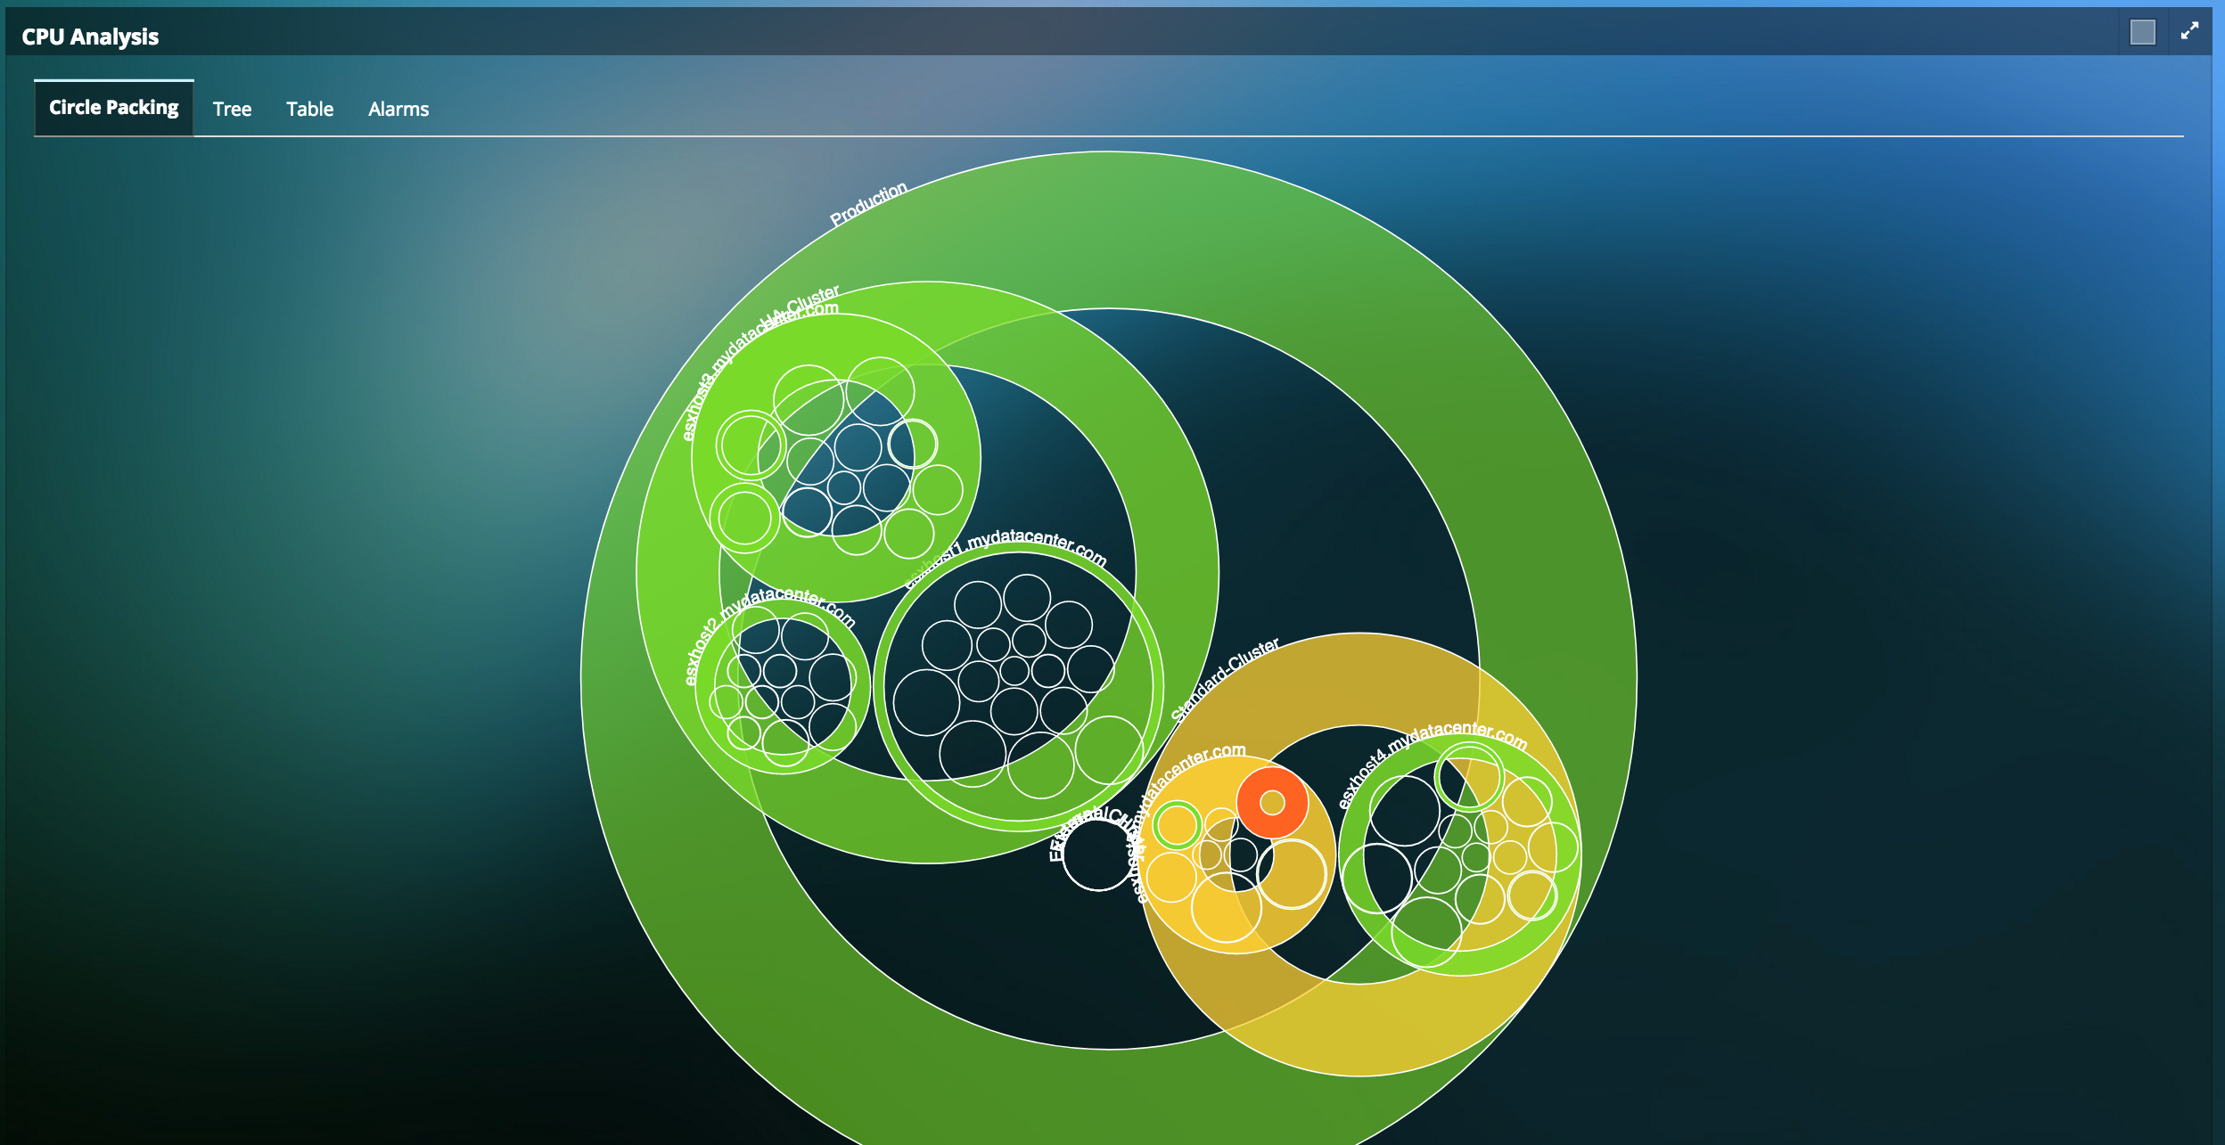
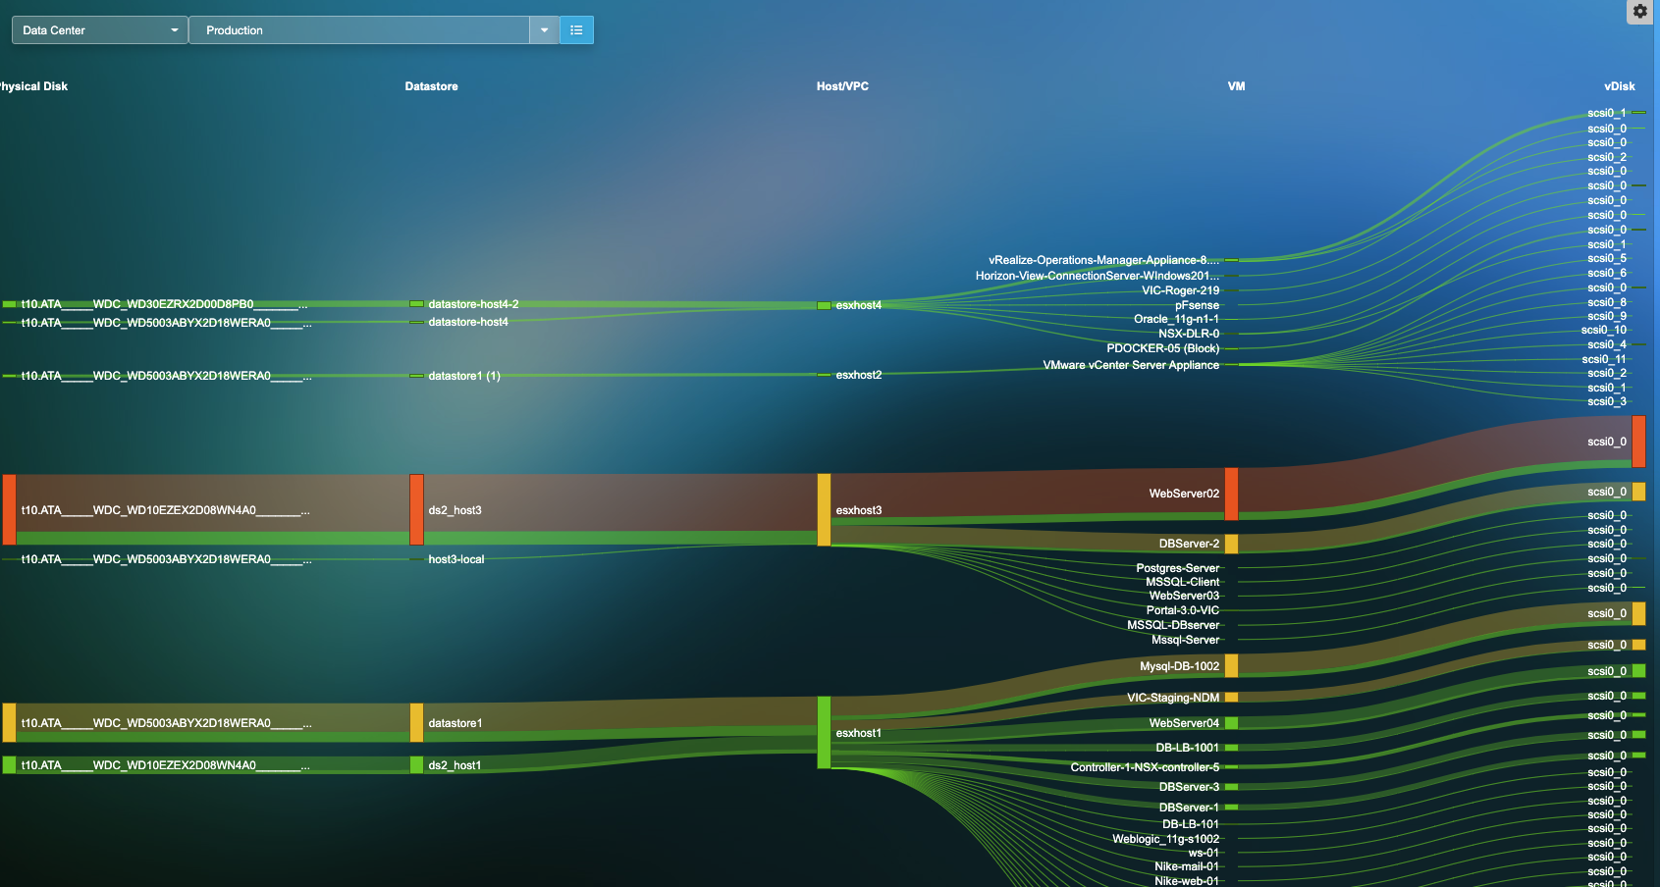
PRODUCT SCREEN 3 OF 5
Infrastructure hot-spots & storage path analysis
Find the over-committed host or the slow datastore before users feel it
CPU circle-packing heat map
Storage path Sankey
Data centre → cluster → host → VM in one picture. Size shows allocation, colour shows pressure. The red dot is the VM to look at.
Physical disk → datastore → host → VM → vDisk. Trace a latency spike end-to-end and see exactly which workloads share the contended spindle.
Uila uObserve™ | Application-Centric Full-Stack Observability
APAC Authorised Partner · securecentral.com.au
08

Slide 9
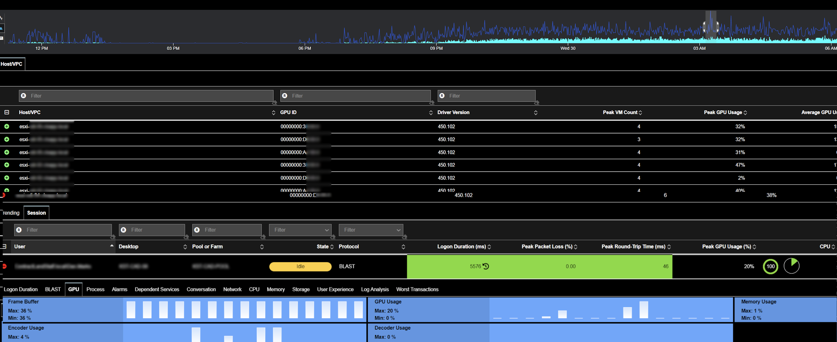
PRODUCT SCREEN 4 OF 5
VDI, GPU and hybrid-workforce experience
Agentless session analysis for VMware Horizon — logon duration, protocol latency, GPU and packet loss
Session-level truth
Per-user desktop, pool/farm, state, protocol (BLAST/PCoIP), logon duration, peak packet loss and round-trip time.
GPU observability
Frame buffer, encoder, decoder and GPU usage per host and per session — essential for designer, trading-floor and clinical workloads.
Ends the 'it's slow' ticket
Prove whether the cause is the endpoint, the WAN, the host or the application — without touching the desktop.
Uila uObserve™ | Application-Centric Full-Stack Observability
APAC Authorised Partner · securecentral.com.au
09

Slide 10
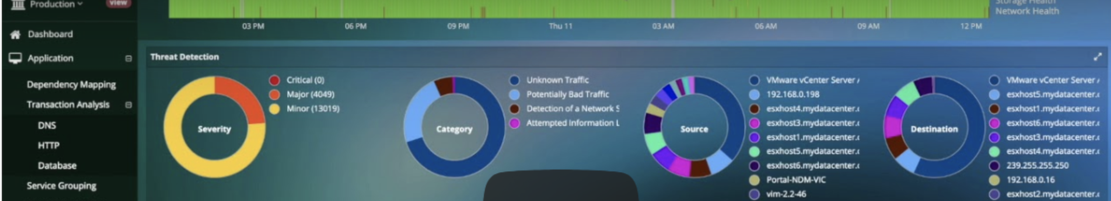
PRODUCT SCREEN 5 OF 5
Cyber threat & application anomaly dashboard
The same east-west metadata that fixes performance also exposes lateral movement
Severity triage
Category breakdown
Source & destination
Anomaly correlation
Critical / major / minor volumes at a glance for the shift lead.
Unknown traffic, potentially bad traffic, network scans, information leaks.
Which host or instance initiated it and where it went — internal or external.
Deviation from the learned application map, plus outbound country insight.
Uila uObserve™ | Application-Centric Full-Stack Observability
APAC Authorised Partner · securecentral.com.au
10

Slide 11
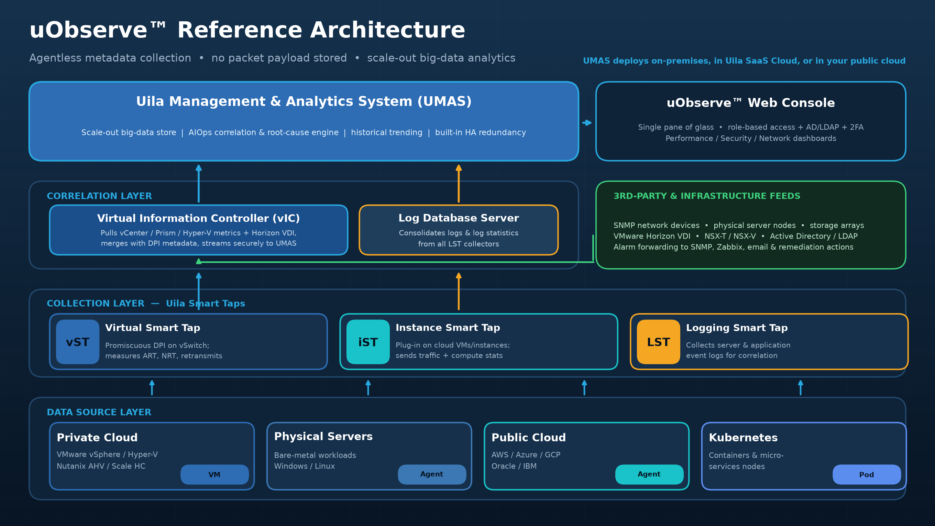
Uila uObserve™ | Application-Centric Full-Stack Observability
APAC Authorised Partner · securecentral.com.au
11

Slide 12
ARCHITECTURE DETAIL
What each component actually does
Four software elements — all virtual appliances or plug-ins, nothing to rack
Virtual Smart Tap
vST
Guest VM on the host (private cloud), VM/instance (public cloud) or Kubernetes node. Listens promiscuously to the virtual switch for north-south and east-west traffic, applies DPI, and emits application + network metadata only — never payload.
1 vCPU · 2 GB RAM · 4 GB disk
Instance Smart Tap
iST
Lightweight plug-in distributed across public-cloud VMs and instances. Collects traffic plus instance-level compute statistics and forwards them to the vST for deep packet inspection.
t2.large (AWS) · D2s v3 (Azure)
Virtual Information Controller
vIC
The integration conduit to vCenter, Hyper-V, Nutanix Prism, OpenStack and VMware Horizon. Pulls network, storage and compute metrics, merges them with DPI metadata from every vST, and securely streams the result to UMAS.
4 vCPU · 24–48 GB RAM
Management & Analytics System
UMAS
The brain: a scale-out big-data store and analytics engine with built-in redundancy. Correlates application behaviour to infrastructure metrics, pinpoints root cause, retains high-resolution history and drives the console.
On-prem, Uila SaaS or public cloud
Uila uObserve™ | Application-Centric Full-Stack Observability
APAC Authorised Partner · securecentral.com.au
12

Slide 13
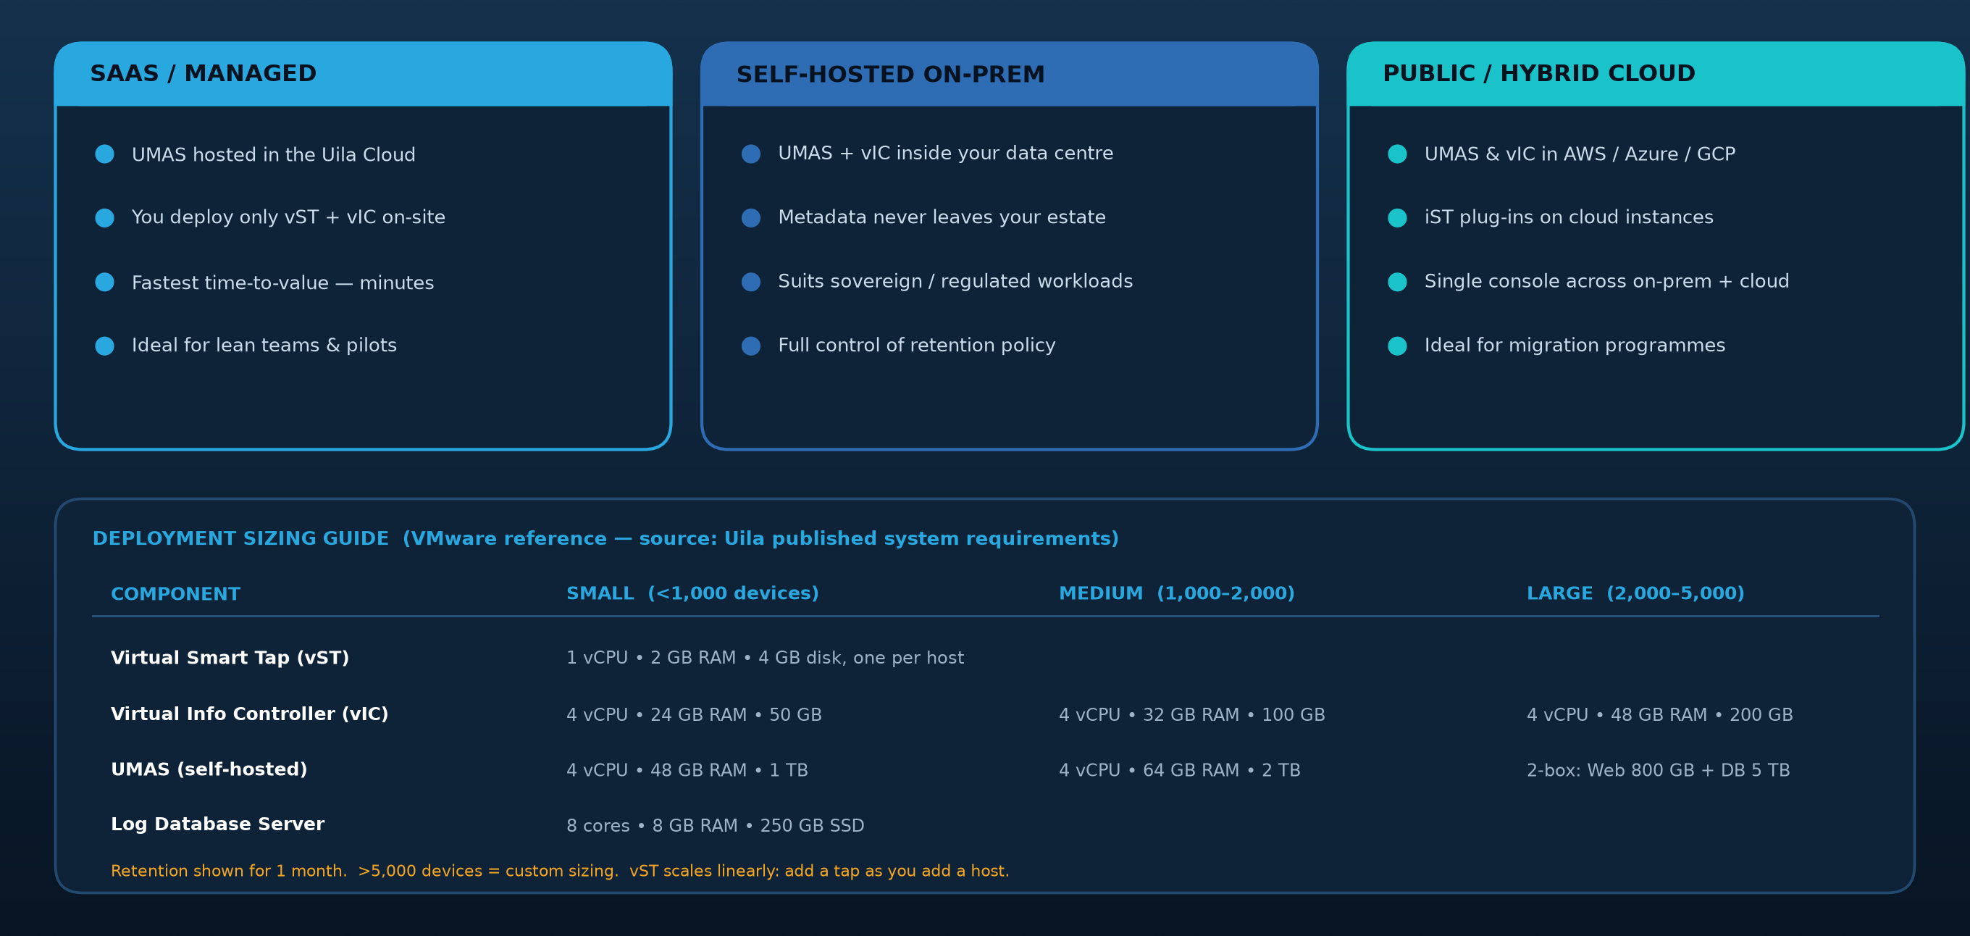
DESIGN & DEPLOYMENT
Three deployment models, one sizing model
Pick the model that fits your data-sovereignty and operating preference — capability is identical
Uila uObserve™ | Application-Centric Full-Stack Observability
APAC Authorised Partner · securecentral.com.au
13

Slide 14
DESIGN & DEPLOYMENT
A typical enterprise rollout
Concrete steps — sequence them to suit your change calendar
1. Discover
2. Deploy
3. Baseline
4. Operationalise
5. Optimise
Confirm hypervisor versions and host count
Import vIC and UMAS OVAs (or register for SaaS)
Let DPI classify applications for 7–14 days
Build command-centre dashboards & kiosk views
Monthly rightsizing & capacity review
Size vIC / UMAS from the device count
Connect vIC to vCenter / Prism / Hyper-V
Auto-generate dependency maps per service
Wire alarms to SNMP / Zabbix / email / ITSM
Quarterly dependency/change audit
Agree retention period and data residency
Push vST to each host; add iST in cloud
Tune thresholds per cluster or host group
Enable AD/LDAP SSO, RBAC and 2FA
Feed evidence into migration & DR planning
Prove it first
Uila offers a 21-day free trial and an interactive demo. A sensible pilot is one production cluster plus one business-critical service — enough to show real dependency maps and at least one root-cause win.
Uila uObserve™ | Application-Centric Full-Stack Observability
APAC Authorised Partner · securecentral.com.au
14

Slide 15
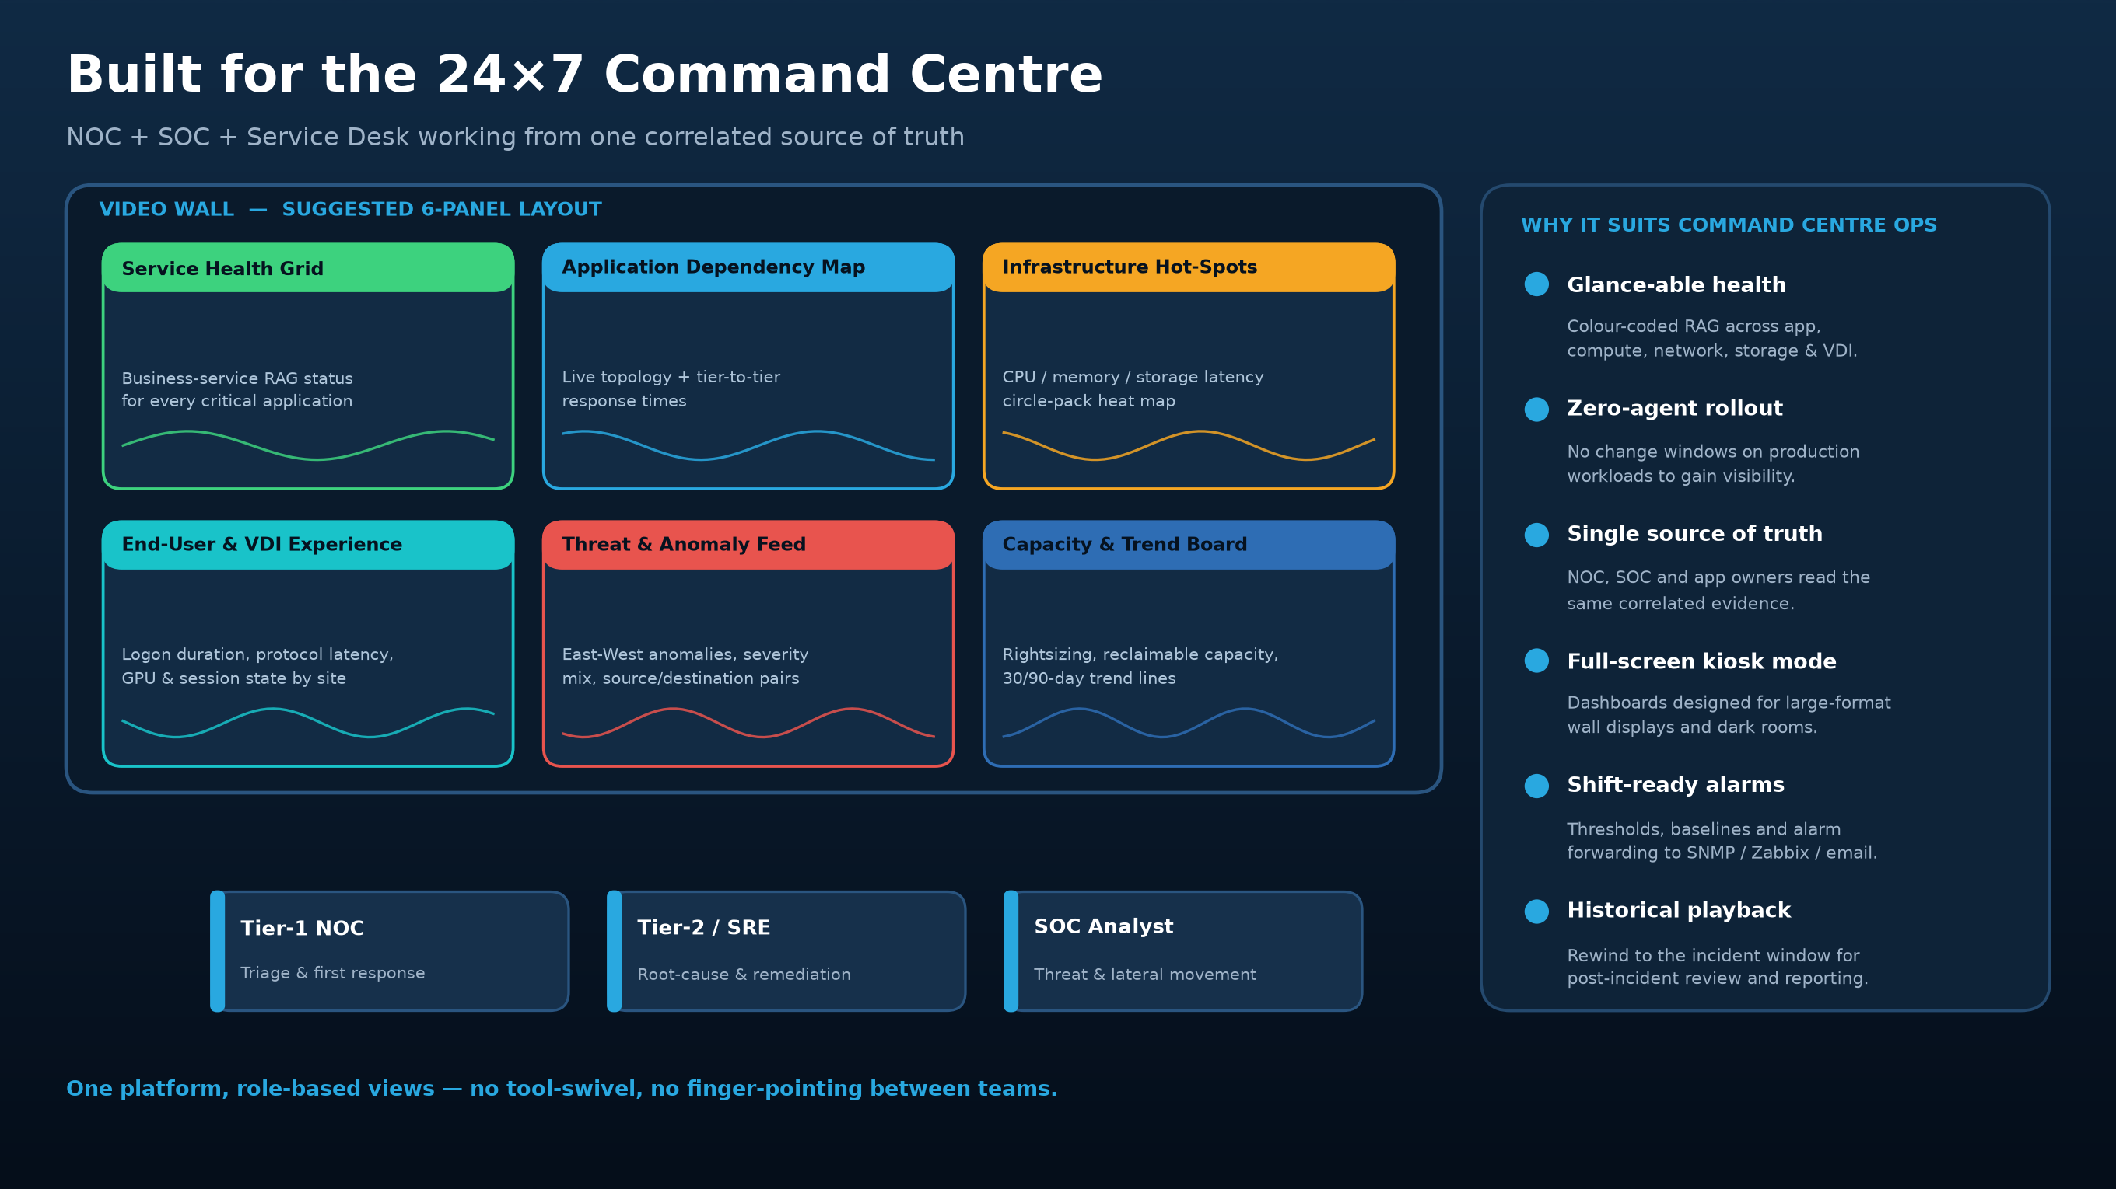
Uila uObserve™ | Application-Centric Full-Stack Observability
APAC Authorised Partner · securecentral.com.au
15

Slide 16
COMMAND CENTRE OPERATIONS
How a shift actually runs on uObserve™
From alarm to closure without leaving the platform
T+0 min
T+1 min
T+3 min
Alarm fires
Triage on the map
Root cause
Threshold or baseline deviation raises an alarm on the wall and to SNMP/Zabbix/email.
Tier-1 opens the dependency map; the degraded tier is already amber/red.
Drill into the node: CPU ready, memory swap, storage IOPS/latency or network retransmits.
T+5 min
T+8 min
Post
Scope the blast radius
Remediate
Review
See every dependent service and user session affected before you communicate.
Apply the AIOps remediation action or hand a precise ticket to the owning team.
Replay the incident window from retained history for the post-incident report.
Uila uObserve™ | Application-Centric Full-Stack Observability
APAC Authorised Partner · securecentral.com.au
16

Slide 17
FEATURES & BENEFITS
What it does — and what the organisation gets
Mapped from capability to measurable business outcome
CAPABILITY
BENEFIT TO THE ORGANISATION
Agentless DPI collection
Visibility in minutes with no code change, no agents on production workloads and no change-board battle
Application ↔ infrastructure correlation
One correlated answer replaces five siloed tools; mean-time-to-innocence collapses
Automated dependency mapping
Accurate, always-current service inventory for migration, DR, audit and change control
Full-stack root-cause analytics
Shorter MTTR, fewer escalations, less unplanned downtime and fewer repeat incidents
VDI / EUC & GPU observability
Hybrid-workforce productivity protected; desktop tickets resolved with evidence
East-west threat & anomaly detection
Lateral movement and data exfiltration surfaced without endpoint security agents
Capacity planning & rightsizing
Reclaim over-provisioned VMs and cut wasted on-prem and cloud spend
Metadata-only, no payload storage
Packet-grade evidence without the privacy, legal or storage burden of full capture
Uila uObserve™ | Application-Centric Full-Stack Observability
APAC Authorised Partner · securecentral.com.au
17

Slide 18
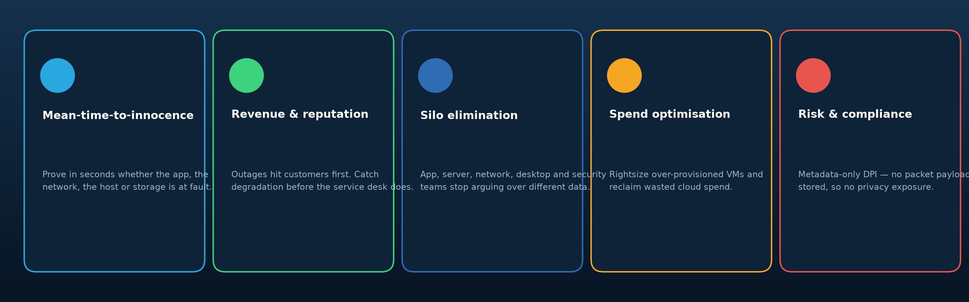
WHY IT MATTERS
Why an enterprise needs this tool
The reasons IT teams give for keeping uObserve™ in the critical path
Accelerate incident resolution
Rapid time to value, low TCO
Maximise IT productivity
Correlated evidence instead of five dashboards
Virtual appliances; no professional-services marathon
Silo elimination across ops, network, desktop and security
Maintain revenue & reputation
Optimise IT spending
Nullify legal & privacy issues
Catch degradation before customers report it
Rightsize what is over-provisioned, on-prem and in cloud
Metadata only — no packet payload retained
Uila uObserve™ | Application-Centric Full-Stack Observability
APAC Authorised Partner · securecentral.com.au
18

Slide 19
PROOF
Organisations that run on Uila
A selection of publicly referenced customers across government, finance, healthcare, legal, education and service providers
Harris County
City of Sioux Falls
Baron Capital
First Tech Federal Credit Union
Migdal Group
US county government
Municipal government
Investment management
Financial services
Insurance & finance
Quarles & Brady LLP
The Myers-Briggs Company
GDS
Lake Emergency Medical Services
Bay Area Community Health
Legal services
Assessment & publishing
Data centre service provider
Healthcare / emergency
Healthcare
Wurth Industry
Security Central
BYU Hawaii
Boston Architectural College
Netcor (German insurer)
Industrial distribution
Monitoring services
Higher education
Higher education
MSP / insurance
Also: a US multinational telecommunications R&D division, an APAC government industrial ministry, and a global wine producer.
“We have been able to solve all the complaints that have been directed towards my team for infrastructure-driven application complaints.”
Mark Martinez — IT Director, Harris County
Uila uObserve™ | Application-Centric Full-Stack Observability
APAC Authorised Partner · securecentral.com.au
19

Slide 20
PROOF
In their own words
Published customer testimonials and review-site feedback
“Uila's ability for virtual environment visibility is something I have not seen in any other product.”
“We were able to trace back all the conversation flows, and identify problems that we didn't even know existed in our environment that was dragging us down.”
Henry Mayorga — CSO & VP of Infrastructure, Baron Capital
Brandon Morris — Lead System Administrator, City of Sioux Falls
“In 1 second we were able to tell the Application guys that there is nothing wrong with the Infrastructure… I was able to tell them which server, which port had the issue.”
“We can take proactive steps using Uila to mitigate issues, whereas before we just had to wait for that magical call.”
Snir Hoffman — Migdal Group
Art Piwcio — Director of Infrastructure & Applications, Security Central
“Uila went from being a need, to a pilot, to a critical piece of our virtualised infrastructure in a matter of weeks.”
“Very high-end monitoring system with a very cheap price comparing to existing products in the market.”
Jim Root — CIO, Lake Emergency Medical Services
ShuChung Chang — Director of IT, Bay Area Community Health
Uila uObserve™ | Application-Centric Full-Stack Observability
APAC Authorised Partner · securecentral.com.au
20

Slide 21
FIT
Who uses it, and for what
Industry-aligned use cases and the roles that live in the console every day
BY INDUSTRY
BY ROLE
Finance
Trading latency, branch experience, regulated change control
CIO
Service health and spend in one report
Healthcare
Clinical system uptime, EMR response, imaging storage paths
IT Architect
Dependency truth for migration and DR design
Government
Citizen services, sovereign deployment, cyber threat visibility
IT / Network Operations
Fast triage and root cause on shift
Telecom / MSP
Multi-tenant service assurance and SLA evidence
Cloud Engineer
Hybrid workload visibility and rightsizing
Education
Campus VDI, enrolment peaks, lab capacity
CSO / Security Engineer
East-west anomaly and lateral movement
Retail
POS and e-commerce transaction performance at peak
Desktop Engineer
VDI and end-user experience evidence
Uila uObserve™ | Application-Centric Full-Stack Observability
APAC Authorised Partner · securecentral.com.au
21

Slide 22
COMPARISON
Why uObserve™ instead of more of the same
How the approach differs from classic APM, NPM and infrastructure monitoring
Classic APM
Classic NPM / flow
Infra monitoring
Uila uObserve™
Agents / code instrumentation on every app
Sees north-south, misses east-west
Green dashboards while users suffer
Agentless DPI across east-west and north-south
Blind to infrastructure root cause
Flow records lack application context
Resource metrics with no app meaning
Application ↔ infrastructure correlated in one engine
Licensing scales painfully with hosts
No compute or storage correlation
Separate tool per silo
Performance, dependency and security in one console
The one-line version
Uila is the only layer that sees the conversation AND the infrastructure carrying it — which is why it can tell you the cause, not just the symptom.
Uila uObserve™ | Application-Centric Full-Stack Observability
APAC Authorised Partner · securecentral.com.au
22

Slide 23
YOUR APAC AUTHORISED PARTNER
Uila, delivered locally by SecureCentral
Enterprise software, delivered with expertise you can trust — www.securecentral.com.au
Value-Driven Technology Partnership
Solution Consulting
SECURECENTRAL IN APAC
We take enterprise software vendors to market across Asia Pacific — recruiting, contracting and activating the right reseller network in each country.
Certified pre-sales architects who scope, demonstrate and prove Uila alongside your team — including proof-of-value deployments.
12+
years in APAC distribution
8
markets served
Managed Support
Marketing & Demand Generation
Regional first-line and second-line support in local time zones, escalating to the vendor only when it is genuinely needed.
Co-branded campaigns, localised collateral and lead generation that partners can run out of the box.
5
delivery countries: AU · NZ · SG · MY · ID
What this means for your Uila deployment
Local contracting
Deployment expertise
Local-hours support
Broader stack fit
Buy in-region, in your currency,
under APAC terms
Sizing, vST/vIC/UMAS rollout and
dashboard design done with you
First and second line in your time
zone before vendor escalation
Integrated with ITSM, ITAM, cyber
and remote-support practices
Uila uObserve™ | Application-Centric Full-Stack Observability
APAC Authorised Partner · securecentral.com.au
23

Slide 24
NEXT STEPS
YOUR APAC AUTHORISED PARTNER
See it on your own
infrastructure.
Licensing, deployment, enablement and local first- and second-line support for Uila across Asia Pacific.
1
Interactive demo
A guided walk-through of the live console — no install.
Web
www.securecentral.com.au
2
21-day free trial
Email
info@securecentral.com.au
Deploy vIC + vST in your lab or a production cluster.
Infrastructure & performance assessment
Phone
+61 424 135 693
3
Uila-led assessment producing a dependency map and hot-spot report.
Markets
AU · NZ · SG · MY · ID
4
Design workshop
SecureCentral Global Pty Ltd · A Pioneer Infotech Company
Agree model, sizing, retention and command-centre dashboards.
www.uila.com • Free trial: uila.com/free-trial • Delivered in APAC by SecureCentral: info@securecentral.com.au • +61 424 135 693

Slide 25
APPENDIX
Sources & assumptions
So every claim in this deck can be traced
Product capability, pillars and positioning
uila.com — Performance Observability, Application Dependency Mapping, Cyber Threat Protection pages
Architecture and component roles
uila.com/products/how-it-works and the uObserve User Guide (vST, iST, LST, vIC, Log DB Server, UMAS)
Sizing figures in the deployment table
uila.com/products/uila-system-requirements (VMware reference, 1-month retention)
Customer names and quotations
uila.com/products/customer-testimonials and published success-story PDFs
Platform support (vSphere 8, Horizon, NSX-T/V, Nutanix, Hyper-V, Scale)
Uila press releases and technology-partner pages
Screenshots
Product screens published on uila.com; cropped for legibility, otherwise unmodified
SecureCentral partner details, markets and practice areas
securecentral.com.au — home page, Uila partner page and business registration footer
Assumption: the command-centre video-wall layout and the five-stage rollout plan are Uila-informed recommendations by the author, not vendor-published artefacts.
Uila uObserve™ | Application-Centric Full-Stack Observability
APAC Authorised Partner · securecentral.com.au
24

